Slide 1
Atos
XUnit & Mock
Eduardo Olea

Slide 2
01
Introduction to Software Testing.
04
XUnit
02
Types of software testing.
05
Mock
03
Unit Testing

Slide 3

Software testing

Slide 4
Xunit & Mock
What is software testing?
Software testing is defined as the activity to check whether the actual software match the expected results and to ensure that the system is Defect Free.

Slide 5
Types of Software Testing.

Slide 6
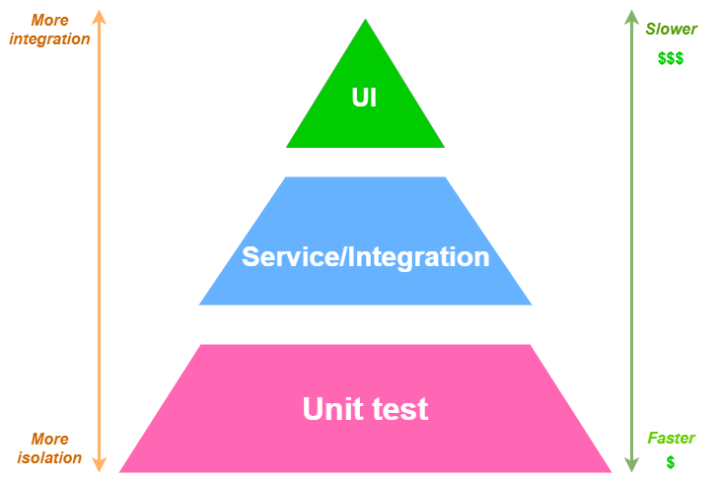
Xunit & Mock
Types of tests
Three types of tests
End to End Tests
Integration Tests
Unit Tests

Slide 7
03.
Unit Testing

Slide 8

Xunit & Mock
What is unit testing
Verify small parts of the app, like classes, components, or methods
Features:
They execution time is short
They are developed fast
They don’t depend on external elements
They don’t depend on another unit tests

Slide 9

Xunit & Mock
What is unit testing
Unit test structure (AAA)
Arrange: Section where we prepare the data to test
Act: Section where we execute the component to test
Assert: Section where we prove if the result is the one, we expect

Slide 10
04.
XUnit

Slide 11
XUnit & Mock
What is XUnit & Test Driven Development
XUnit is the latest technology open-source unit testing tool for .NET Framework
It has more potential than other tools, its more oriented to TDD (Test Driven Development)
TDD: It is a way to develop software where you first write the tests, usually unit tests, and then after, write the necessary code to pass the test.

Slide 12

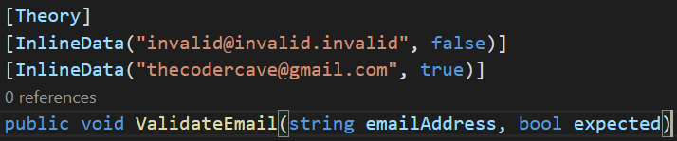
Xunit & Mock
Xunit Test Structure

Slide 13

XUnit & Mock
XUnit Example

Slide 14
05.
Mock

Slide 15
XUnit & Mock
What is Mock
The definition of mock we take in this context is mimic, We have to invent interfaces to access data so they don’t fail
We can't insert test data in the database
All the unit testing have to be tested individually so we can’t call external services, so the solution is imitated them
In short, mocking is creating objects that simulate the behavior of real objects.
We can have a interface for a repository and instead of a concrete Implementation, in the same test Class we going to implement how this object will behave

Slide 16

XUnit & Mock
Mock Structure
You need to install from the nuget packages: dotnet add package Moq
.Setup to identify the methods that you going to simulate, it helps to simulate the interface logic
.Object property that allows you to access the type you are imitating, each of them is going to be a repository
.Verify Function calls that you simulate with the setup that you want to execute

Slide 17
XUnit & Mock
Mock Types
There is five types of Mock
.Setup to identify the methods that you going to simulate, it helps to simulate the interface logic
.Object property that allows you to access the type you are imitating, each of them is going to be a repository
.Verify Function calls that you simulate with the setup that you want to execute

Slide 18
Xunit & Mock
Mock Example

Slide 19




For more information please visit: https://atos.net/es-mx/mexico

